Slide 1

Mismatched training and dev/test data
Bias and Variance with
mismatched data
distributions
deeplearning.ai

Slide 2
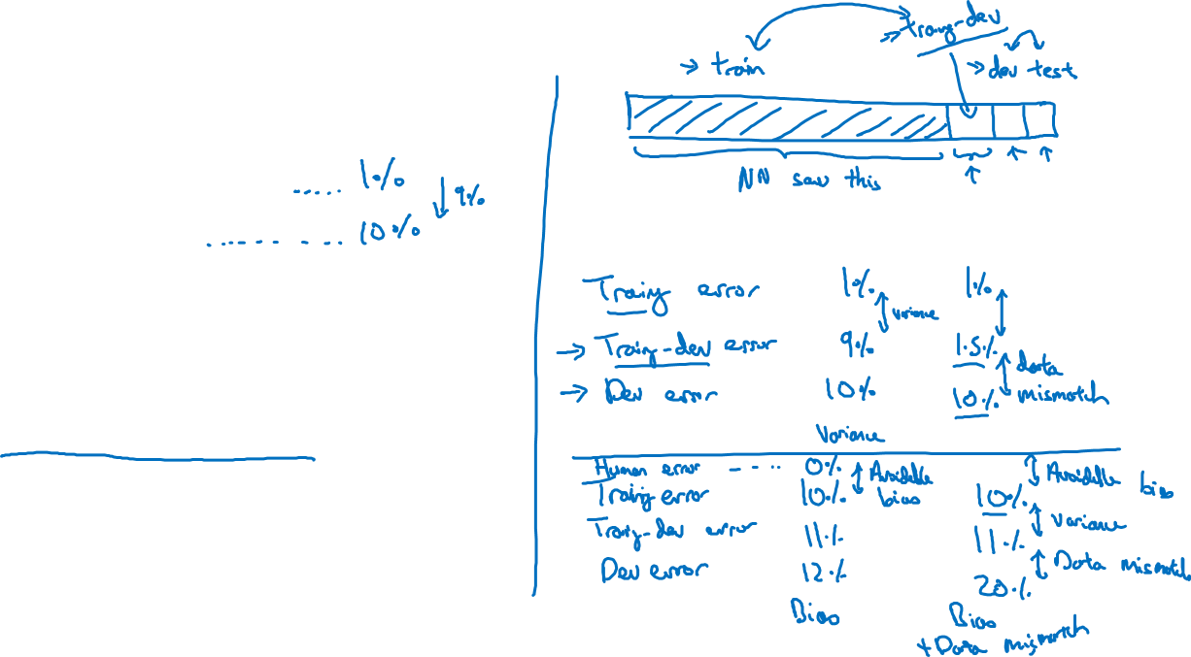
Cat classifier example
Assume humans get ≈ 0% error.
Training error
Dev error
Training-dev set: Same distribution as training set, but not used for training

Slide 3
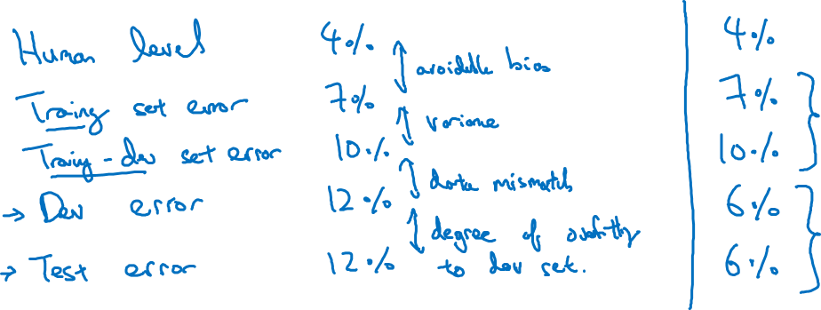
Bias/variance on mismatched training and dev/test sets

Slide 4
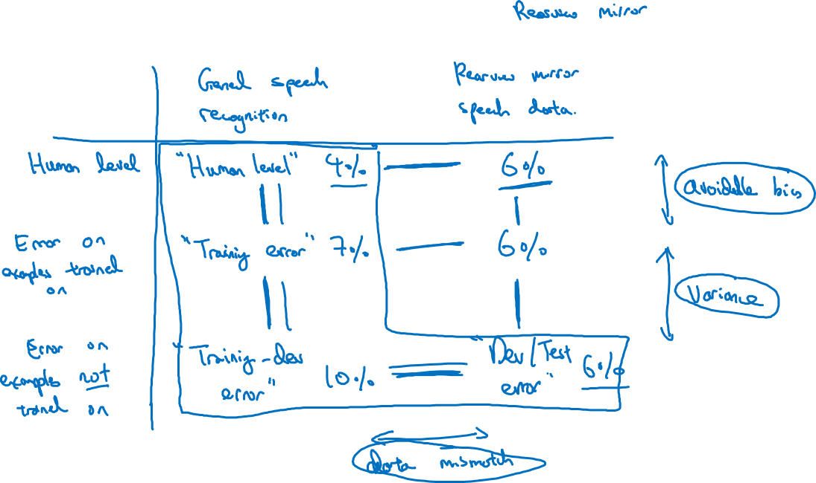
More general formulation

